Slide 1
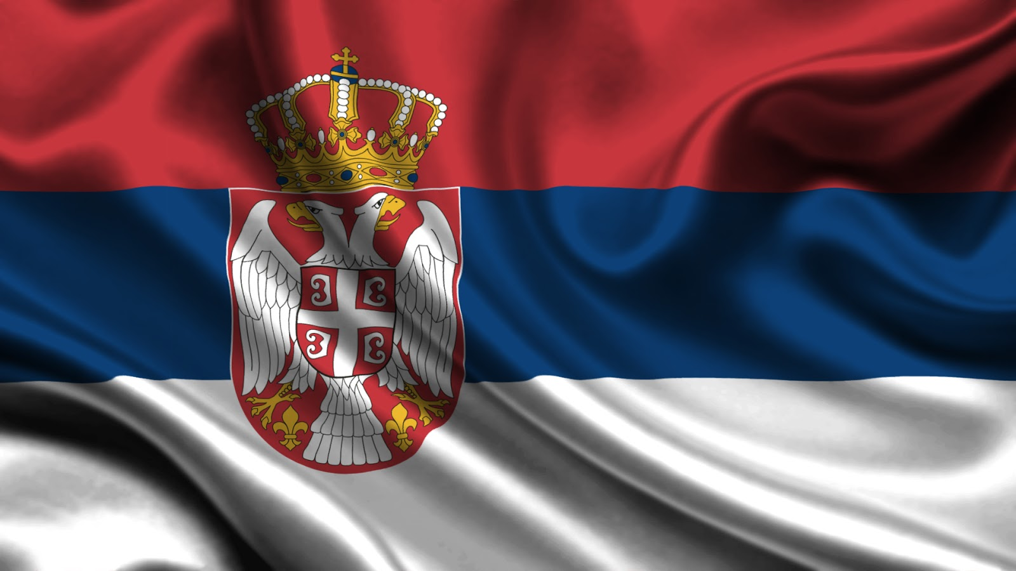
SERBIA

Slide 2
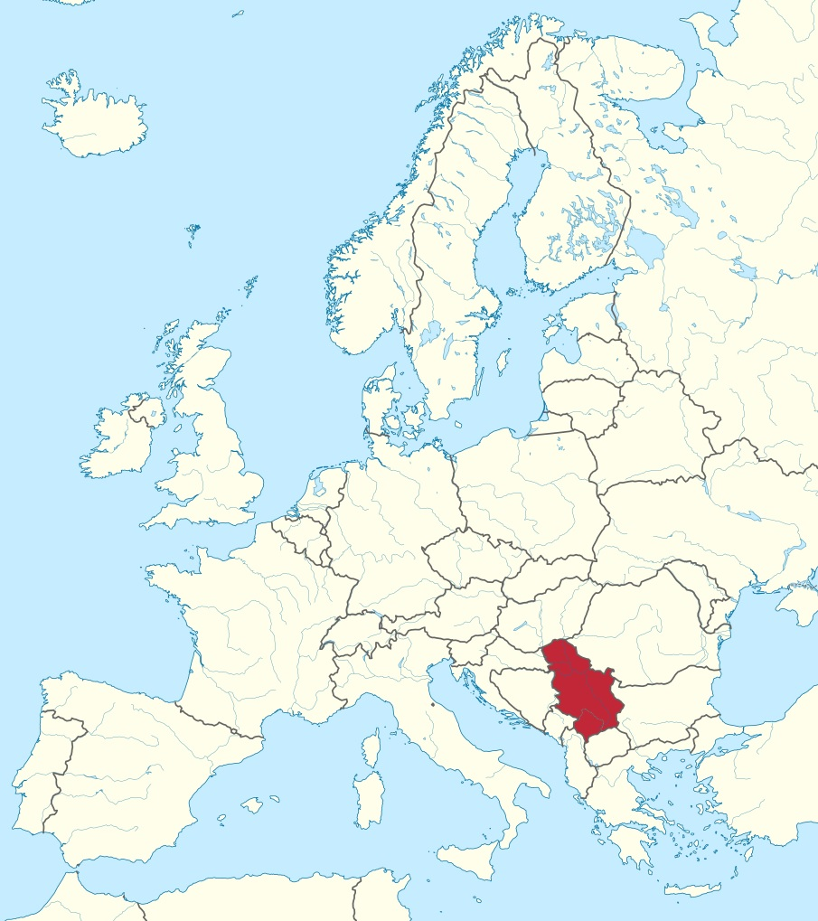

Slide 3
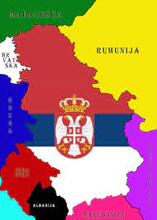
Name: Republic of Serbia
Capital: Belgrade
Location: Southeast Europe, Balkan Peninsula
It borders 8 countries
Area: 88,361 km2 Population: 7,500,000
State system: republic
Currency: dinar
Official language: Serbian
Official script: Cyrillic, but both Cyrillic and Latin alphabet are in use
Climate: mostly moderately continental
Mostly developed sectors: agriculture, mining, automotive industry, energy, tourism
The longest international river flowing through Serbia: the Danube
The longest river in Serbia: Velika Morava
Highest mountain peak: Đeravica, Prokletije (2656 m)

Slide 4
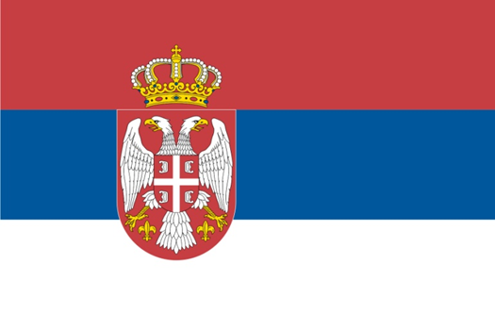
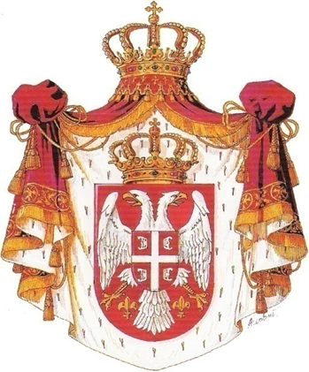
Flag
Symbols of the state
God of Justice
God of Justice, You who saved us
From the disasters of the past,
Today, hear the voices of Your children,
And be our salvation, just as in old times.
Defend with Your mighty hand,
That very future Serbia walks to,
God save; God defend,
Serbian lands and Serbian people!
(…)
Coat of arms

Slide 5
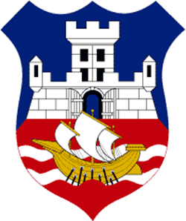
Belgrade

Slide 6
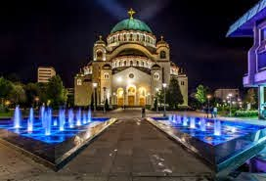
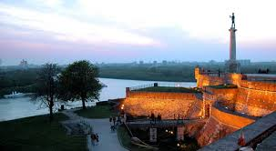
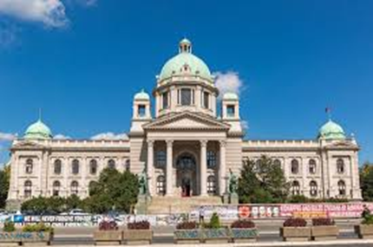
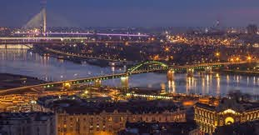
Belgrade is the capital and it ranks among the largest and the oldest cities in the Southeastern Europe.

Slide 7
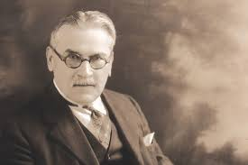
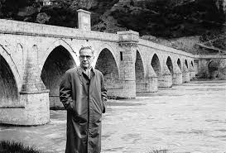
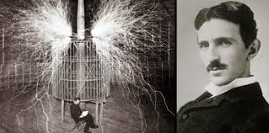
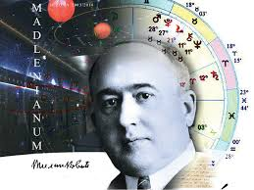
Famous Serbian People
Mihailo Pupin-scientist
Ivo Andric-Nobel winning writer
Nikola Tesla-scientist
Milutin Milankovic
-mathematician

Slide 8
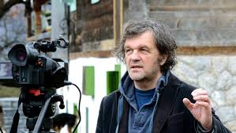
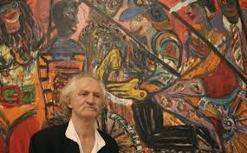
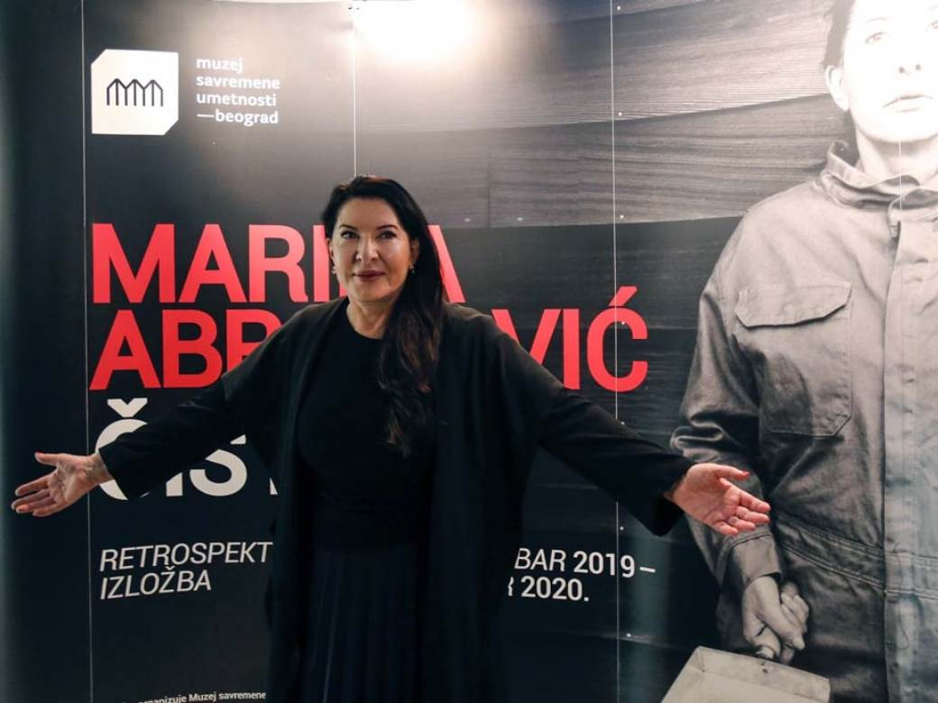
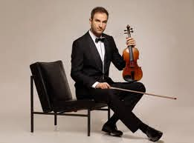
Emir Kusturica
Art
Milan Cile Marinkovic
Marina Abramovic
Stefan Milenkovic

Slide 9
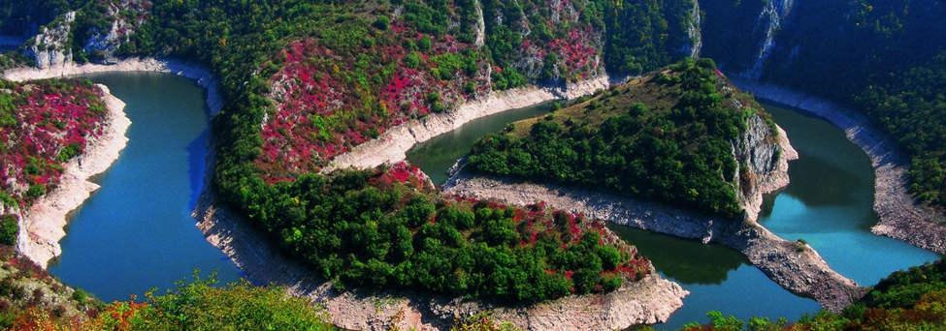
Serbia is a country full of natural beauties, from the vast plains in the north to the high mountains in the south. There are some of the most breathtaking sceneries that cannot be seen anywhere else in the world (Canyon of the Uvac river, Devil’s town, Djerdap national park and many other special nature reserves, mountains, lakes, and spas.
Special nature reserve Uvac

Slide 10
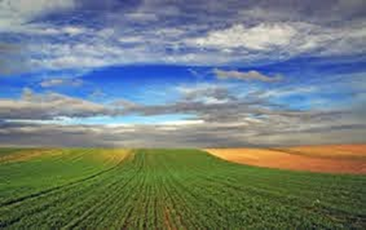
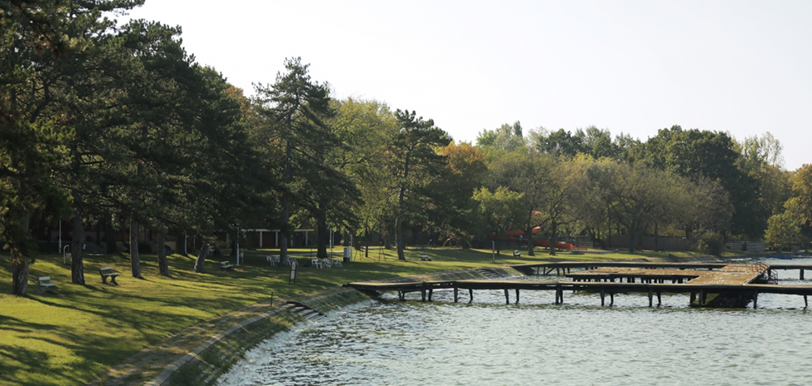
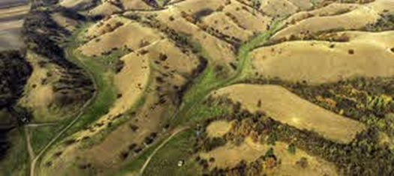
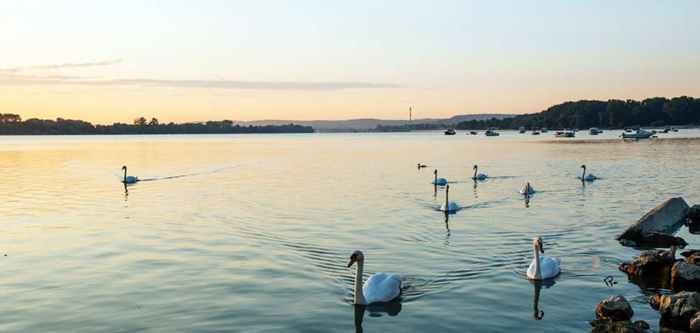
Srem plain
Lake Palić
The Danube river
Deliblato sandy hills

Slide 11
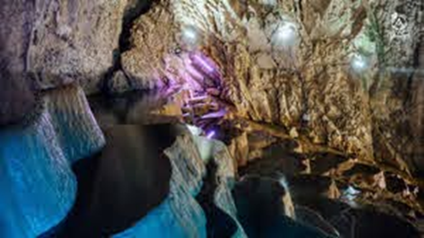
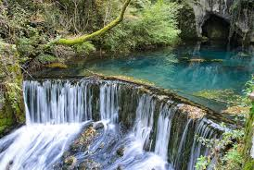
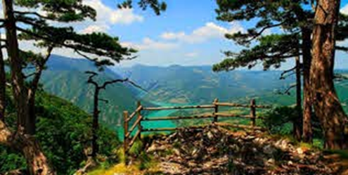
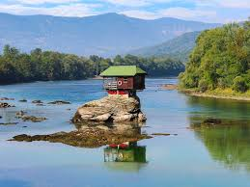
Stopica cave Krupanj’s spring
Tara National Park The Drina river

Slide 12
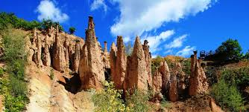
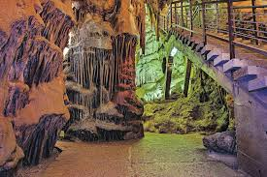
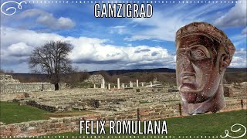
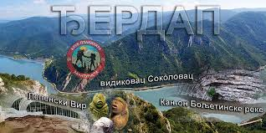
Devil’s town Resava’s cave

Slide 13
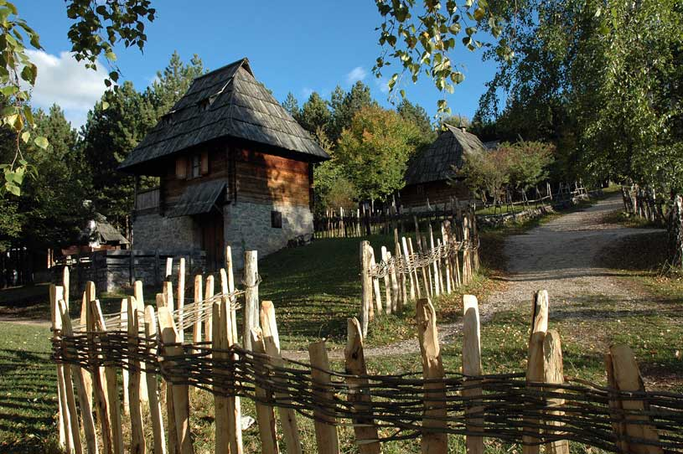
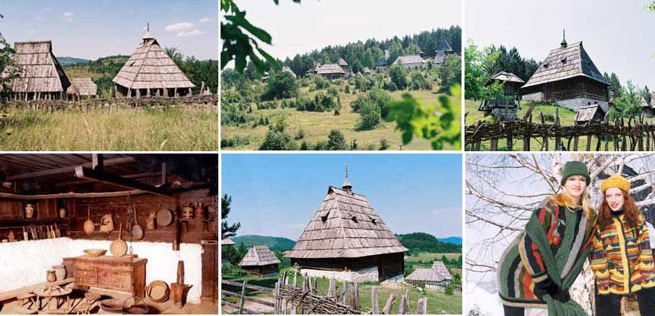
Sirogojno- museum in open space, representing old Serbian villages

Slide 14
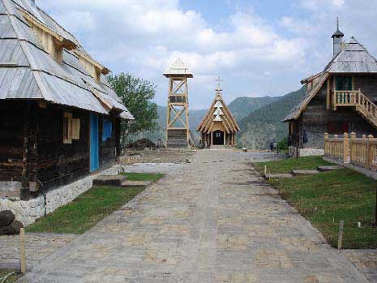
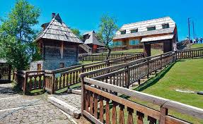
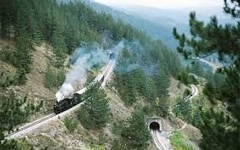
Mokra gora – Drvengrad (wooden town)
Shargan railway- unique way of traveling from the past

Slide 15
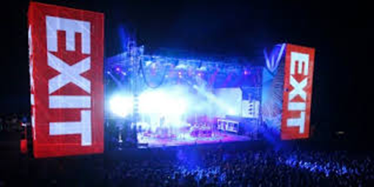
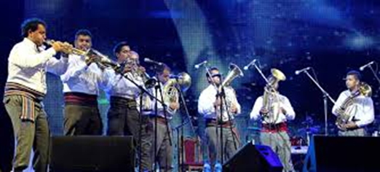
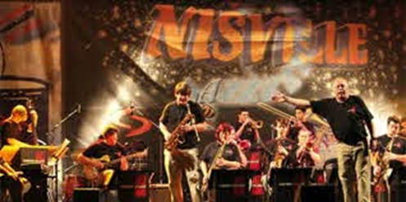
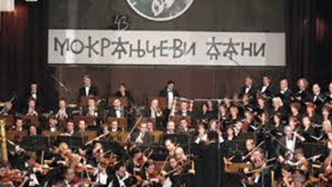
Serbia is known for large music festivals that gather hundreds of thousands of people, from country and abroad. They listen to all types of music - from traditional folk music, through classical, jazz to pop, rock and techno.

Slide 16
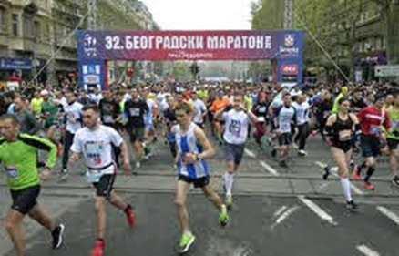
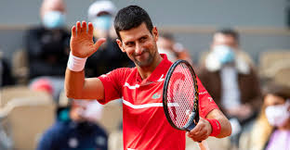
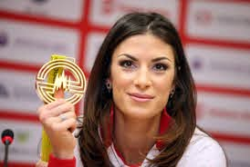
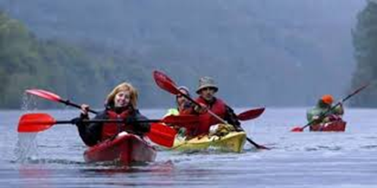
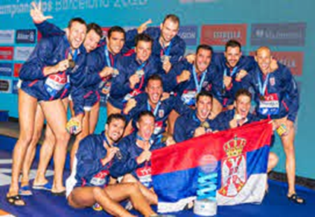
Serbia has given the world top basketball players, volleyball players, tennis players, water polo players and many other athletes who have achieved significant results at the world level.
Here, the love for sports is nurtured from an early age, through numerous sports events, the most massive of which attract tens of thousands of people.

Slide 17
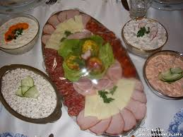
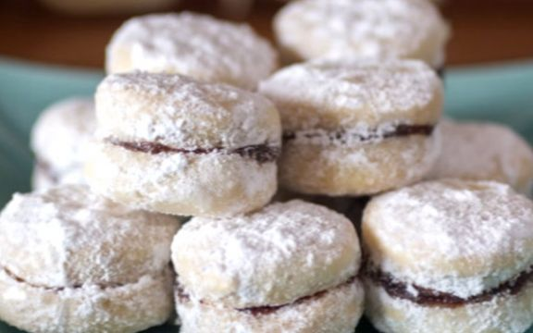
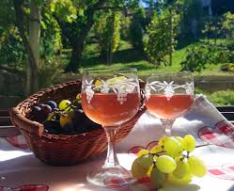
Food and drink
Serbia is a country where “quality food" is produced and eaten. Delicious soups and stews, vegetable, pastry and meat dishes, and irresistible sweet desserts are found daily on both restaurant menus and tables across the country. Some of the national dishes are: sarma, Karadjordje’s steak, kiebabs (ćevapćići), all kinds of grilled meat, roasted meat (pečenje) cooked beans, cheese pie (gibanica), meat pie (famous burek), all kinds of homemede dry meat and sausages and homemade cheese and cream.
From sweets you can try different kinds of strudel, pies, famous biscuits fiilled with marmelade called vanilice (it won the gold medal for quality in the world contest!), donuts and many others.
Serbia is also famous for strawberry, raspberry and blueberry production and for their exportation. Fruits such as apples, pears, plums, grapes, apricots and quinces are used both for eating, for jam and marmelade production as well as for production of high quality brendies.
Beside iressistible food very quality wines and brandies are produced in family manufactories. If you prefer soft drinks, you can try top-quality homemade juices or refresh yourself with water from one of the mineral water springs from all over Serbia.

Slide 18
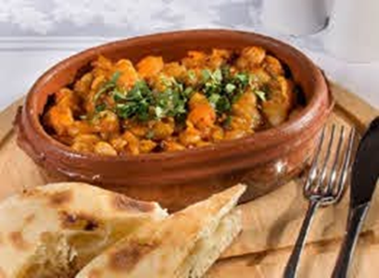
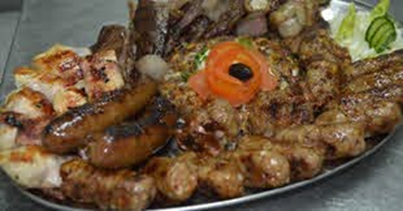

Slide 20
Slava (feast)
Slava is something only Serbians have. Each family has it’s saint, protector of home and the family . On this day people hail the saint and pray for good health and fortune. Slava is celebrated with friends and family. Candle, which burns throughout the day,cooked sweetened wheat and feast bread you don’t cut but break with family members are obligatory.

Slide 21
More than 200 monasteries were built on Serbian soil - witnesses of Serbian history, guardians of culture, tradition, heritage and national identity.
Some of them date back to the eleventh century.

Slide 23
Medieval fortresses of Serbia
Fascinating fortifications have been built on the territory of our country since ancient times, and in addition to being important historical monuments, the fortresses of Serbia leave you breathless with their beauty.

Slide 24
Kalemegdan Fortress

Slide 25
Smederevo Fortress

Slide 26
Nis Fortress

Slide 27
The Petrovaradin Fortress

Slide 28
Backa Fortress

Slide 29
Golubac Fortress

Slide 30
Djerdap gorge-Decibel

