Slide 1
UNEMPLOYMENT AND WORKSHOPS IN TURKEY

Slide 2
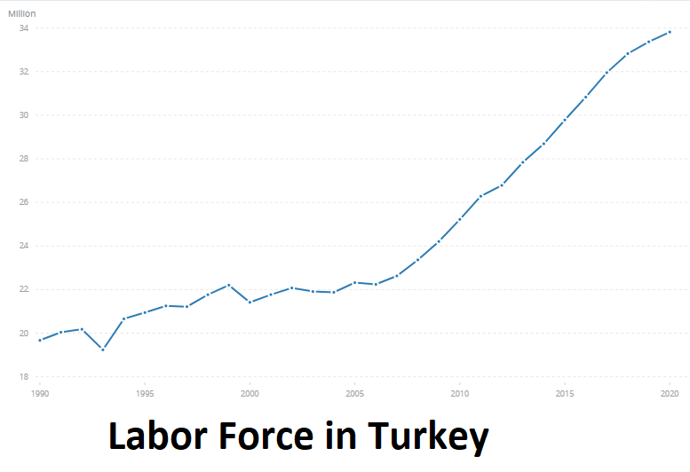

Slide 3
Reasons of Unemployment
Cost-oriented approaches of companies
Employers find the burden of employee taxes and premiums high
High young population
Labor force participation of disadvantaged groups
Education system

Slide 4
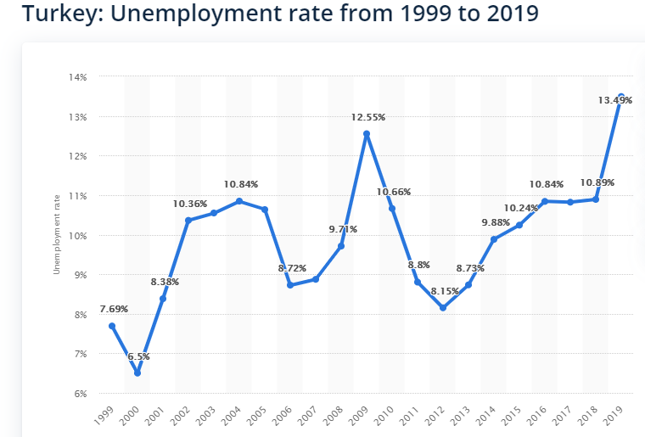

Slide 5
Occupations with the highest employment rate:
Veterinary 80.1 %
Engineering 79 %
Health Services 75.4 %
Law 74.4 %
Medical 74.1 %
Agriculture, forestry and fishing 71.8 %
Architecture 70.7 %
Construction sector 70.7 %
İnformatics and Communication Technologies 70.2 %

Slide 6
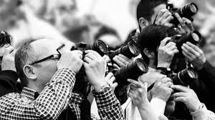
Among college graduates, the highest unemployment rate is in social services with 24.3 percent.
Journalism and information with 23.8 percent,
Art with 17.8 percent,
Occupational health and transportation services with 17 percent,
Physical sciences, biology and environment with 16.9 percent,
Social and behavioral sciences followed with 15.3 percent.

Slide 7
Occupations with lowest unemployment:
Security services 6.3 %
Law 8.3 %
Veterinary 8.9 %
Medical 9.6 %
Education 9.8 %
Mathematics and Statistics 9.9 %

Slide 8
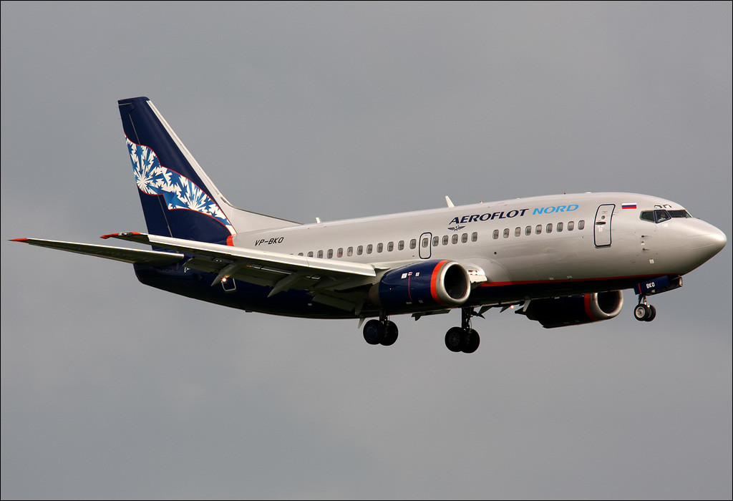
Turkey's Most Prestigious Professions
Medical doctor
Judge
University Professorship
Pilotage
Embassy
Governor
Dentistry
Captaincy
General
Attorney

Slide 9
Professions Preferred By Foreigners In Turkey
1- Customer Service
2- Foreign Language Teaching
3- Babysitting
4- Editing and Interpreting
5- Import-Export Sales Expertise

Slide 10
A Brief Overview of Some Sectors

Slide 11
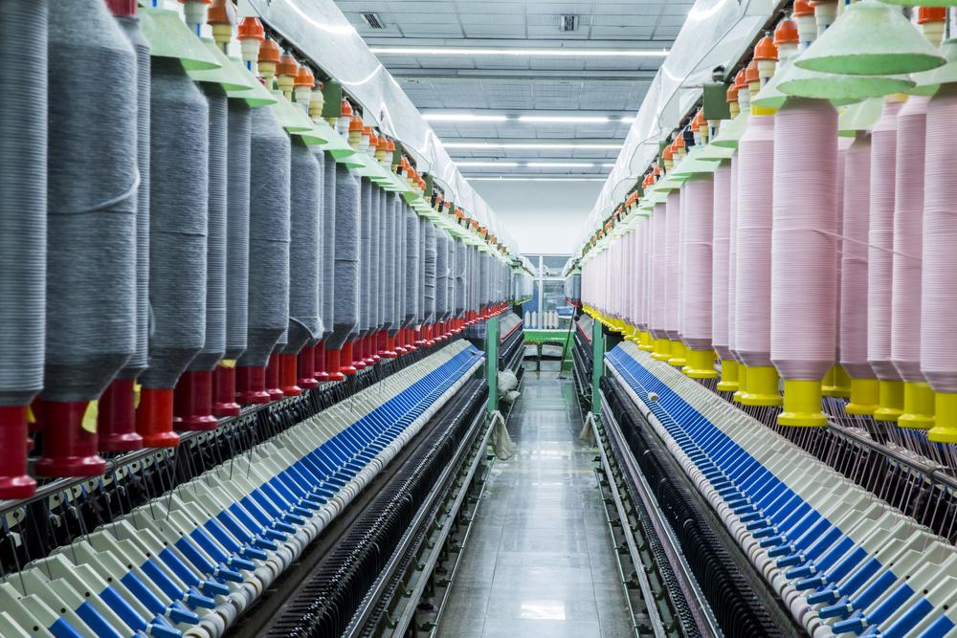
Textiles
Our country has a share of 4.33% in world textile exports which is 254 billion dollars. Turkey finds itself top places in terms of the global textile market, competes with countries like China, India, South Korea, Pakistan, and Vietnam which have a large share in the global market despite the high labor costs thanks to the advantages of raw material and proximity to the market.

Slide 12
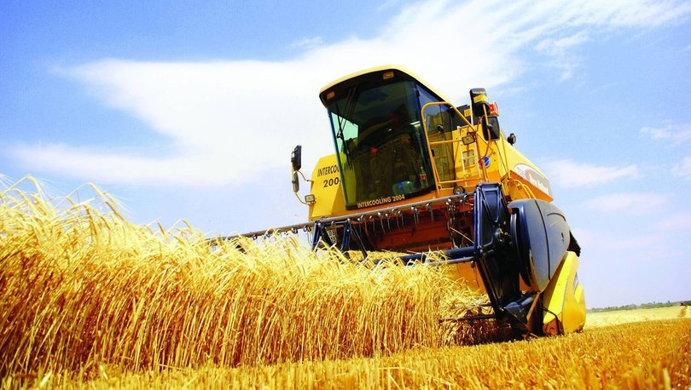
Agriculture
Agriculture is an important sector in Turkey with its contribution to employment, exports, and national income. The agricultural sector is a major economic activity with 6.1 million jobs and $ 62.7 billion in revenue.

Slide 13
Tourism
For developing countries such as Turkey, the tourism sector contributes to national income, foreign exchange revenues, contribution to balance of payments and developed business lines its contribution to the country's economy is quite large with new employment areas created.

Slide 14
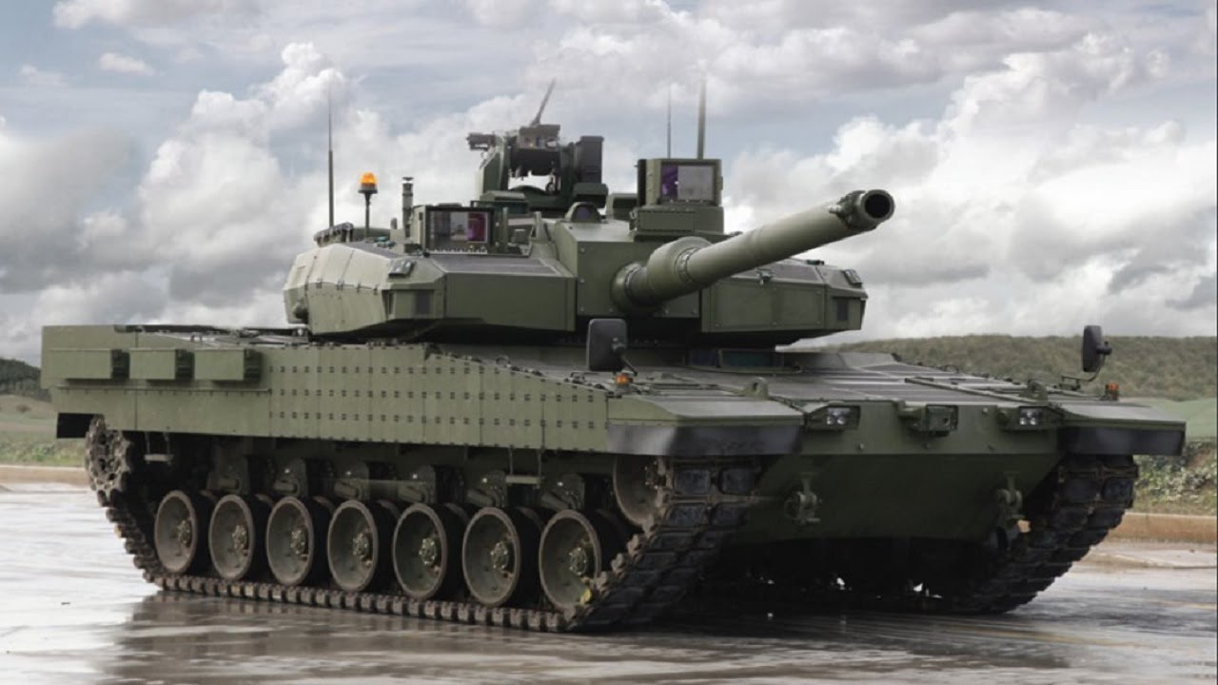
Defense Industry
The Turkish defense industry is able to manufacture national and local products, and has a wide-ranging research and development program among which the main supporting organization is TÜBİTAK.

Slide 15
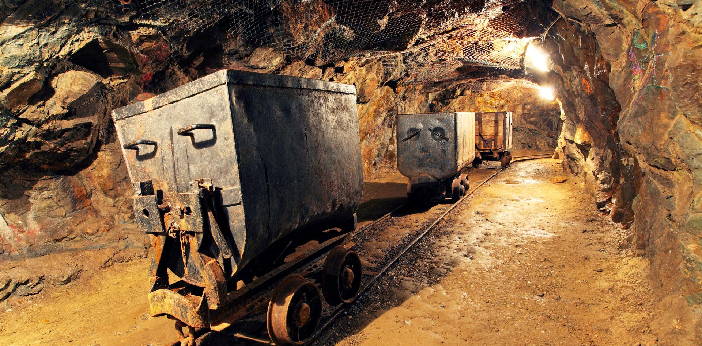
Mining
Mining in Turkey is one of the developed industrial branches. Turkey is a country rich in mines. It is also among the important countries in the world in terms of some mines.

