Slide 1
Young Turkish Entrepreneur:
SERTAÇ TAŞDELEN
Ece Nazik
ALA

Slide 3
THE BEGINNING OF EVERYTHING

Slide 5
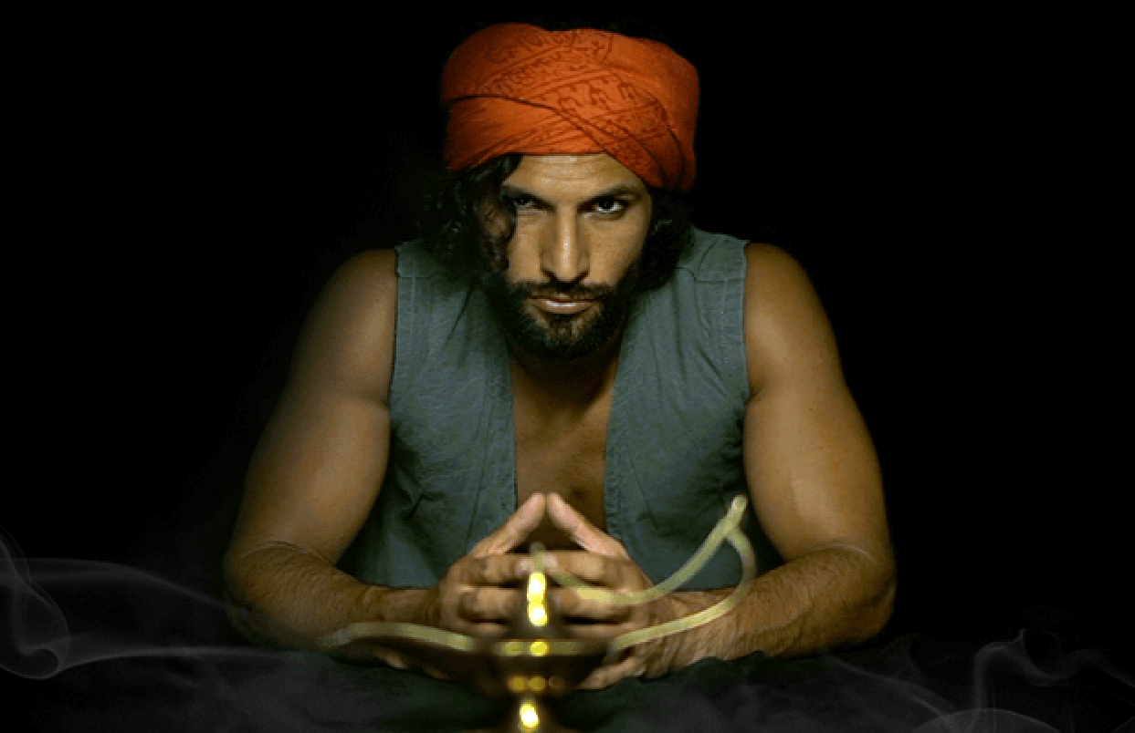

Slide 6
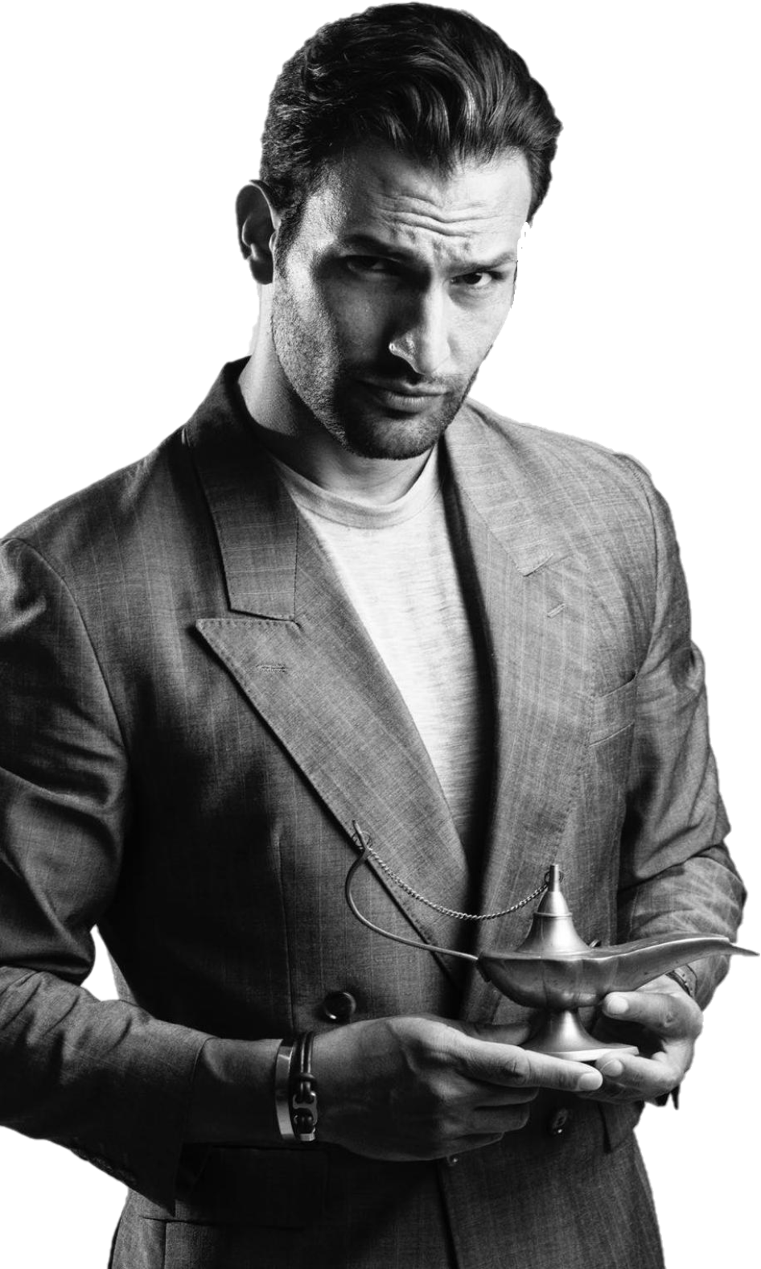
GET TO KNOW YOURSELF

Slide 11
THANKS FOR YOUR ATTENTION

