Slide 1
AN ENTREPRENEURIN TURKEY
Kaan kayabalı

Slide 2
Who is Kaan Kayabalı?
Kaan Kayabalı was born in 17 October 1983/Ankara
In the universty exam he was initial 300 people.
At the fourth grade of universty he realized that he wanted to be entepreneurin.

Slide 4
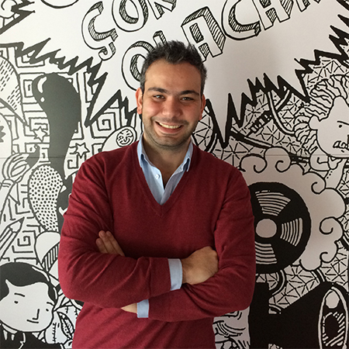
In 2005 he was a graduate from ODTÜ.
Then he made KADE with one of his friends.
Kaan get into a competition called Yeni Fikirler which means new ideas
And he won the competition as a second person

Slide 5
After winning this competition he got an Office and a little bit Money Thats how Onedio came out.

Slide 6
Lets talk about what is onedio. It is a social platform which has tests,magazines, some news and people’s opinions. So basically it is a platform that you can Express your feelings, solve or make some test, read the news. And you can have fun at the same time.

Slide 7
Wherever you live,whoever you are if you work hard and if you be determined about what you really want to do you will be succesful. I just wanted to Show you how much successful he is.

